Slide 1
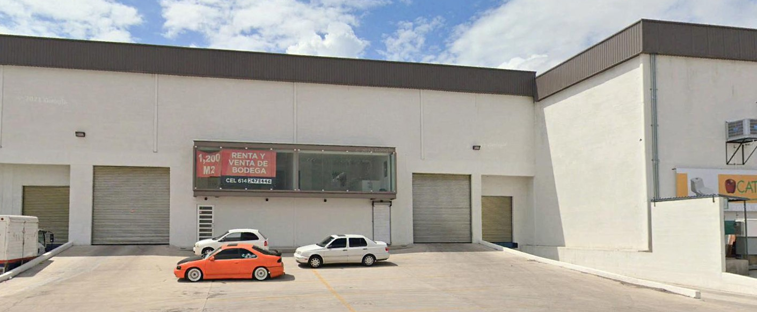
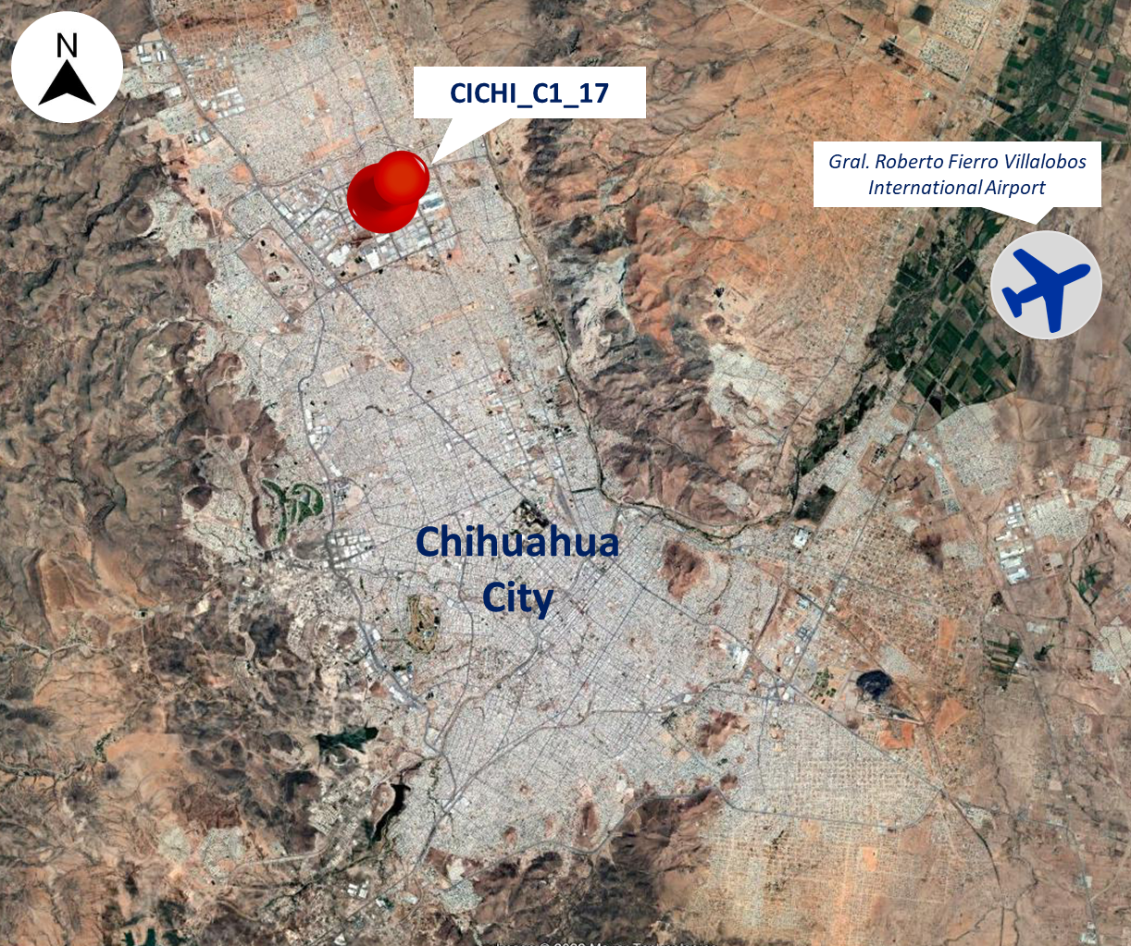
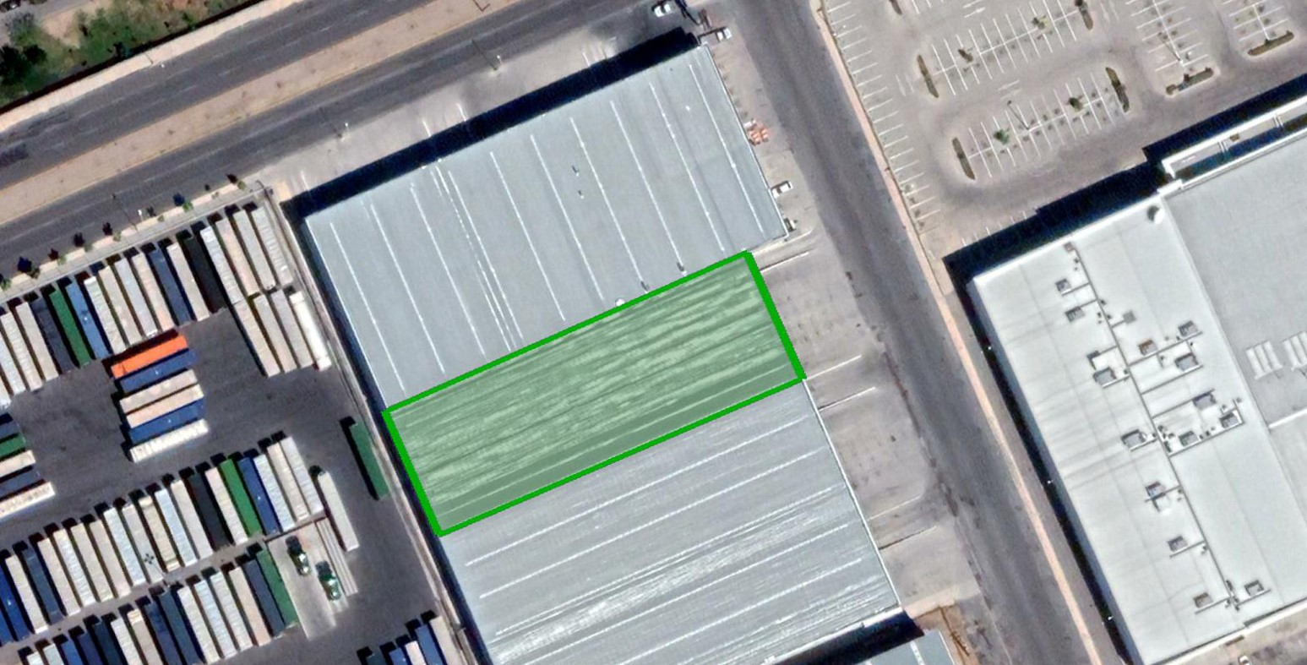
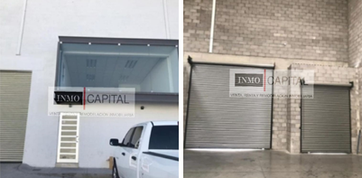
CICHI_C1_17
Industrial Space: 12,863 SF (1,195 m²)
Complejo Industrial Chihuahua | Chihuahua City | Mexico
HIGHLIGHTS
Located inside one of the most important industrial parks in the city.
With access to the main roads of the city.
In close proximity to commercial and residential areas.
Building Specifications
Building area | 12,863 sf (1,195 m²)
Office area | 889 sf (83 m²)
Land area | 13,756 sf (1,278 m²)
Docks | 1
Height | ND
Car parking | ND
C. Gamma, Manzana 9, Complejo Industrial Chihuahua, Chihuahua, Chihuahua, C.P. 31136
AERIAL VIEW

